Slide 1
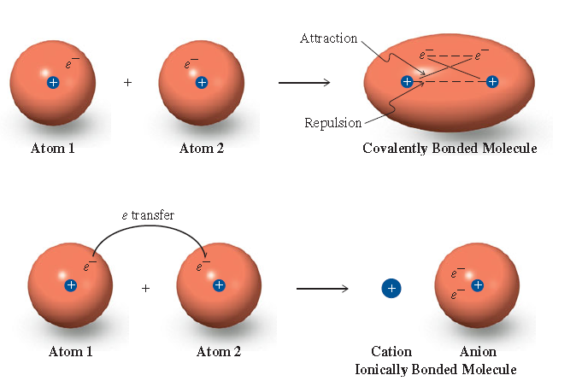
Chemical Bonding I
Chapter 9

Slide 2
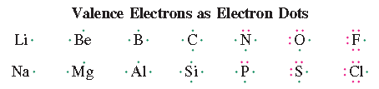
Lewis Structures or, Lewis Dot Symbol
Lews dot symbol consists of the symbol of an element and one dot for
each valence electron in an atom of the element
In Lewis structures, an atom’s valence electrons are represented
by dots.
Valence electrons: Outer shell electrons
Hydrogen has one dot (1s)
Carbon has four dots (2s² 2p²)
Oxygen has six dots (2s² 2p⁴)

Slide 3
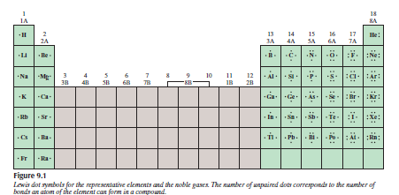
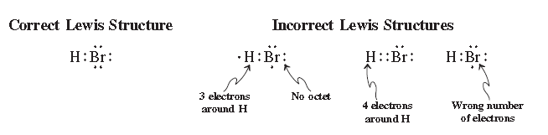
Lewis Structures

Slide 4
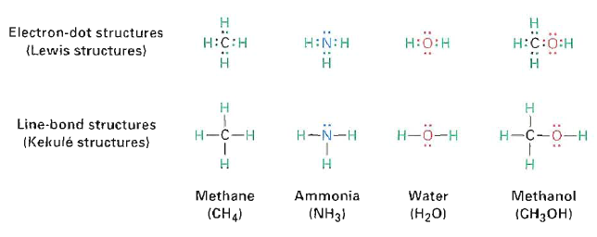
Kekulé structures or line-bond structures
In Kekule structures, the two electrons of a covalent bond are indicated
by a line between the atoms.
A stable molecule results when a noble-gas configuration is achieved for
all atoms- an octet (eight dots) for most elements or two for hydrogen.

Slide 5
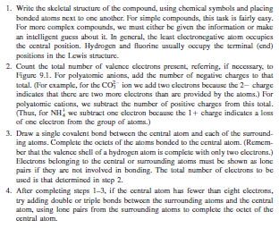
Writing Lewis Structures

Slide 6

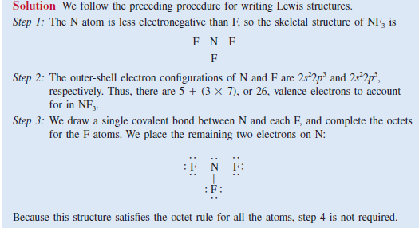

Slide 7

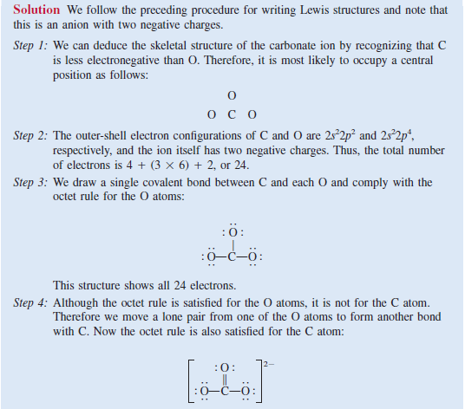

Slide 8
Bonding
Octet rule: The tendency among atoms of Group 1A-7A elements to react in ways that achieve an outer shell of eight valence electrons
  An atom that gains electrons becomes an anion.
  An atom that loses electrons becomes a cation.
  Ionic bond: A chemical bond resulting from the electrostatic attraction of an anion and a cation.
  Covalent bond: A chemical bond resulting from two atoms sharing one or more pairs of electrons.

Slide 9
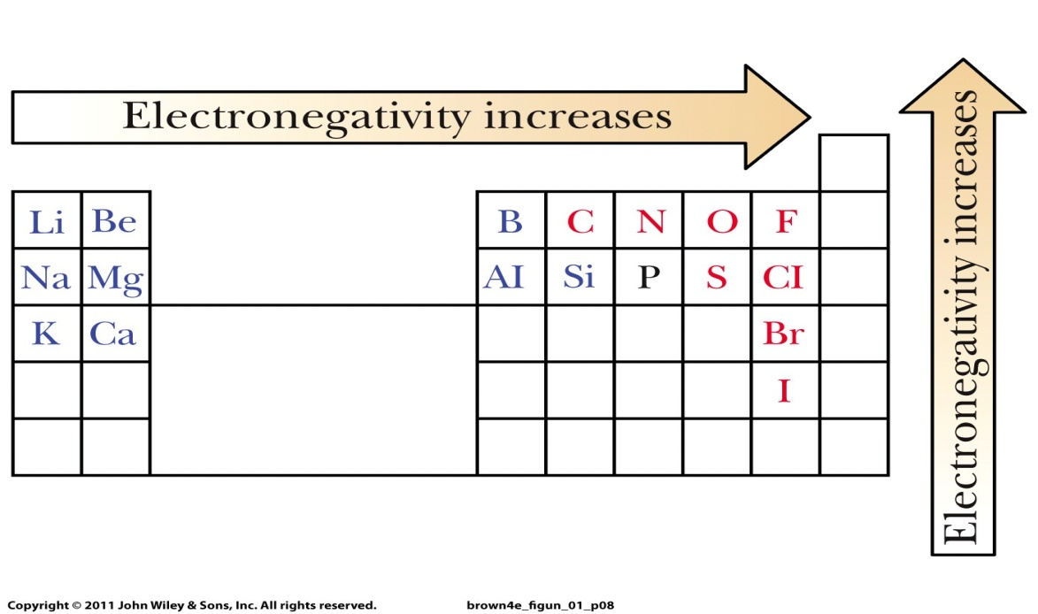
Electronegativity: A measure of the force of an atom’s attraction for the electrons it shares in a chemical bond with another atom.
  Electronegativity increases from left to right within a period.
  Electronegativity Increases from bottom to top in a group.

Slide 10
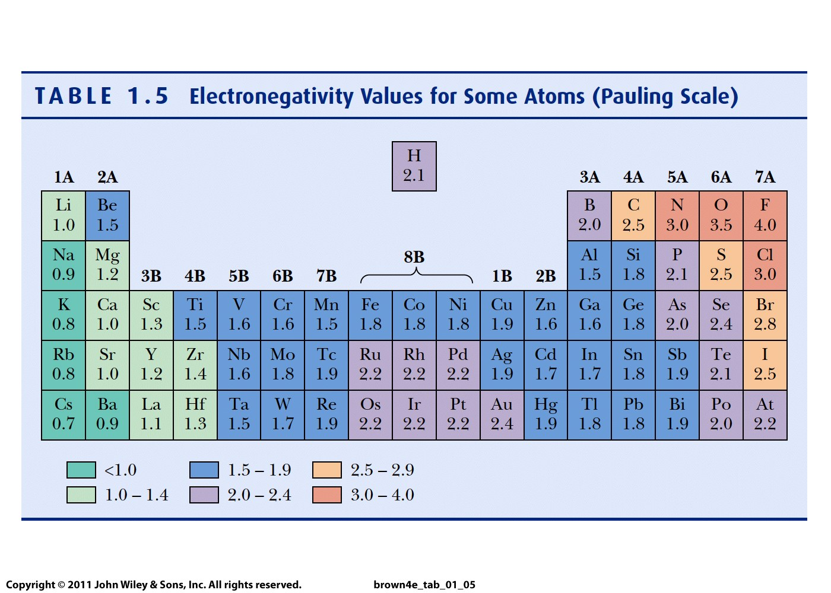
Electronegativity Values for Some Atoms (Pauling Scale)

Slide 11
Ionic Bond
Ionic Bond:
An ionic bond forms by the transfer of electrons from the valence shell of an atom of lower electronegativity to the valence shell of an atom of higher electronegativity.

Slide 12

Consider the reaction between lithium and fluorine to form
lithium fluoride
The electronic configuration of lithium is 1s² 2s¹
The electronic configuration of fluorine is 1s² 2s² 2p⁵
When lithium and fluorine atoms come in contact with each other, the outer
2s1 valence electron of lithium is transferred to the fluorine atom.
Using Lewis dot symbols, we represent the reaction as follows:

Slide 13




Slide 14


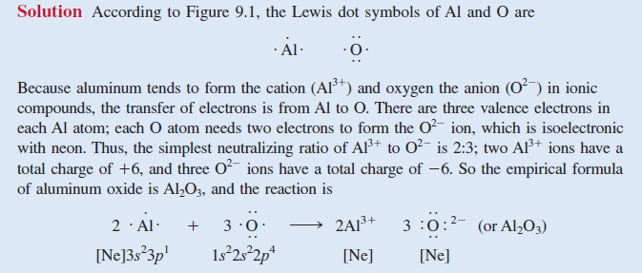

Slide 15

Covalent Bond:
A covalent bond forms when electron pairs are shared between two atoms.
Formation of a covalent bond in H₂
Consider the formation of fluorine molecule, F2
The electronic configuration of F is 1s2 2s2 2p5
Each F atom has 7 valence electrons (the 2s and 2p electrons)

Slide 16


Formation of F₂ is as follows:
Lone pairs: Pairs of valence electrons that are not involved in covalent bond
Formation.

Slide 17
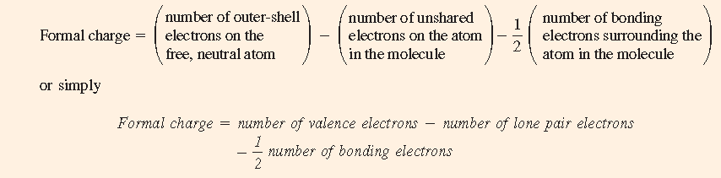
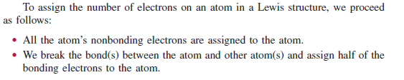
Formal Charge
Formal charge: The charge on an atom in a molecule or polyatomic ion is
called its formal charge

Slide 18
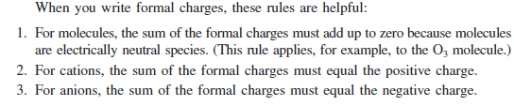

Slide 19

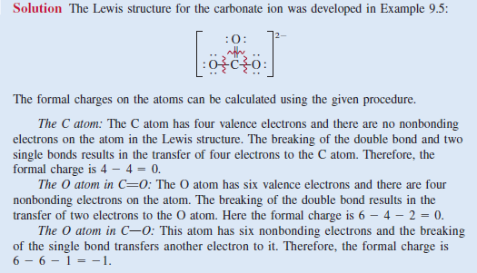

Slide 20
